Slide 1
Internship 2020
A.L.I.C.E.
Cornelius Yap, Tiffany Goh, Samuel Lye

Slide 2
Agenda
Background
Docker and Kubernetes
Openshift
- Openshift Terminal
- Creating New Applications (Build and Deployment)
Routing
Auto Scaling
Load Balancing

Slide 3

Background

Slide 4


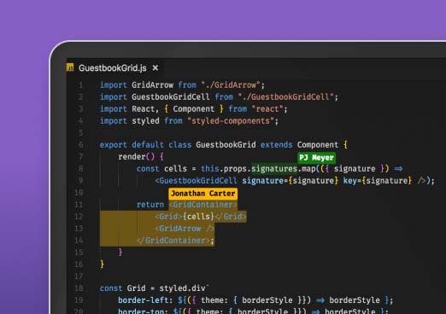


Background

Slide 5
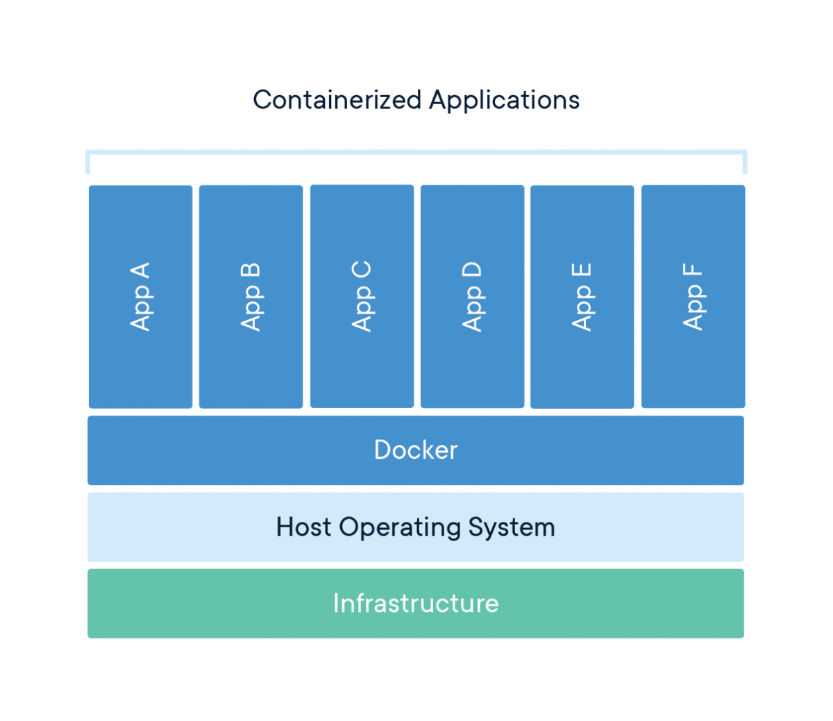
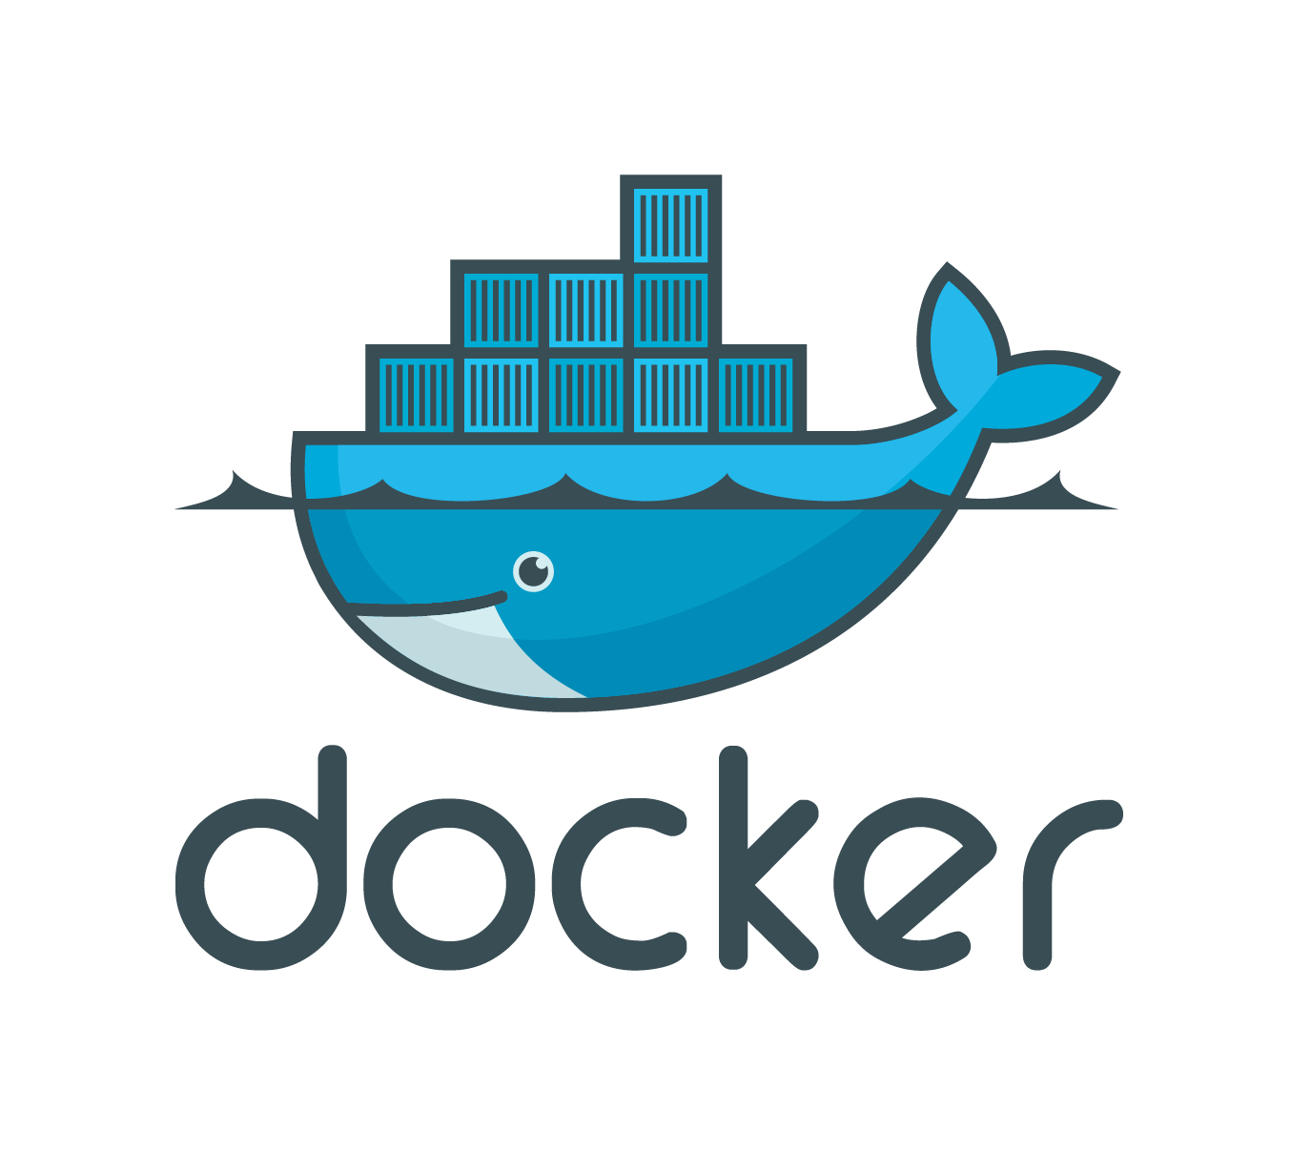
Docker
Notes:
Docker is an open platform for developing, shipping, and running applications. Due to using a variety of ML modules which require different Python modules, we adopted the use of Docker containers to create isolated file systems for our ML modules.
A Docker image is a file, comprised of multiple layers, that is used to execute code in a Docker container. An image is essentially built from the instructions for a complete and executable version of an application, which relies on the host OS kernel.
A Docker container is a runnable instance of an image. Containers are lightweight because they don’t need the extra load of a hypervisor, but run directly within the host machine’s kernel.

Slide 6
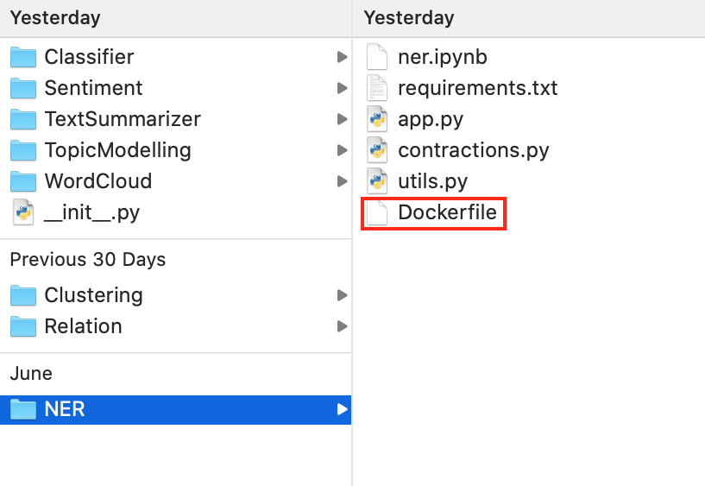
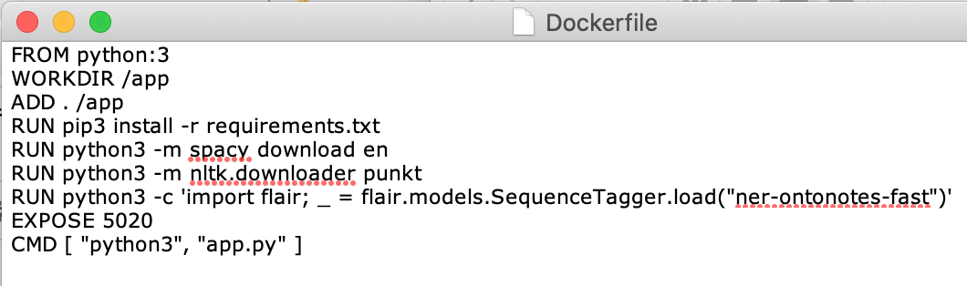
Dockerfile
To start building a Docker image, run the following commands:
cd into the root directory of the folder, e.g. cd NER
run docker build .
run docker run [docker_image] -p 5080:5080
Notes:
A Dockerfile is a text document that contains all the commands a user could call on the command line to assemble an image.

Slide 7
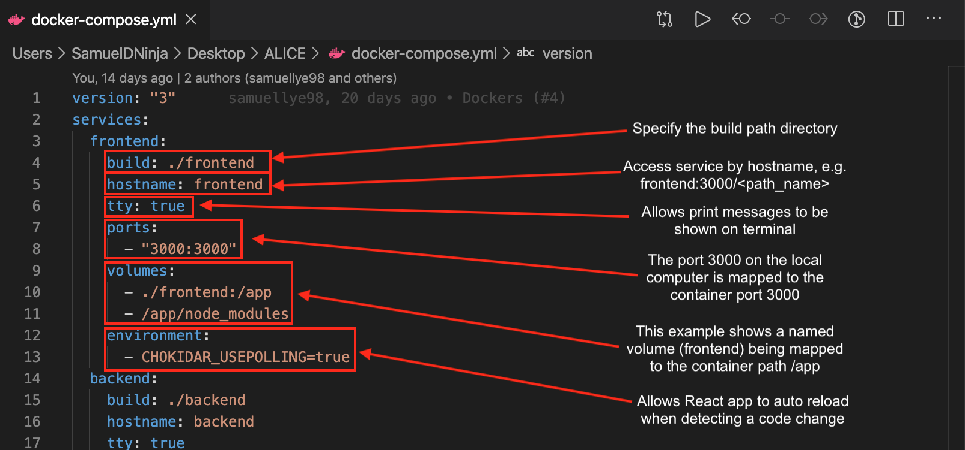
Docker Compose
Docker Compose is a tool for defining and running multi-container Docker applications.
Define a docker-compose.yml file and run docker-compose up. If images are not built, they will be built during the docker-compose up process.

Slide 8
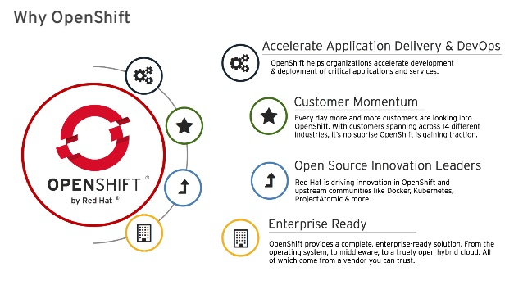
Kubernetes
Red Hat OpenShift is an open source container application platform based on the Kubernetes container orchestrator for enterprise application development and deployment.
Notes:
Kubernetes is an open-source system for automating deployment, scaling, and management of containerized applications.
Kubernetes helps simplify container runtime by managing Docker-based applications that are placed on an underlying system that maintains several replicas of running applications. Kubernetes has enabled developers to accelerate the development of cloud-native applications and created an ecosystem of services that are self-driven and reusable.

Slide 9
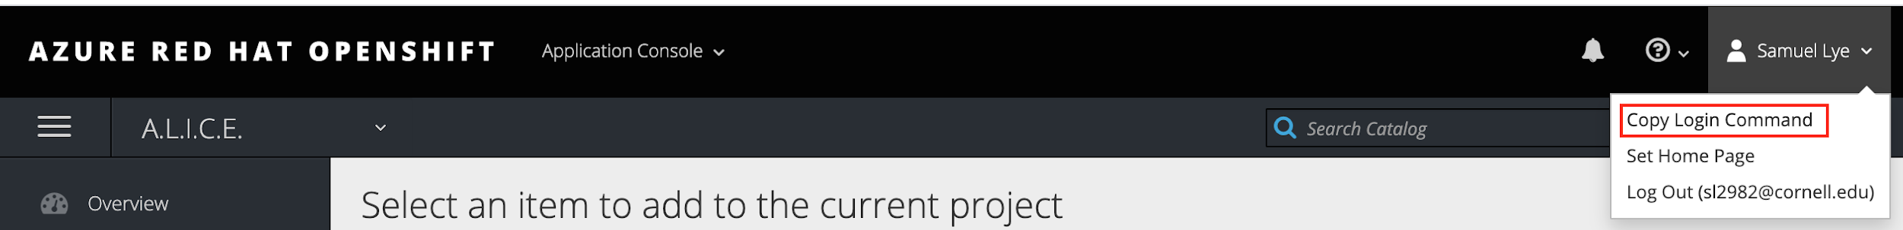
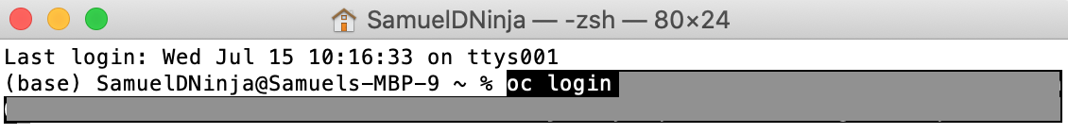
Creating New Applications
To create a new application that will build, deploy, and run an application from your source code, the next few slides will demonstrate how to do so.
First, copy your login command from the Openshift Web Console
2. In your local terminal, paste and run the Openshift Login Command
Notes:
openshift.com/blog/create-s2i-builder-image

Slide 10
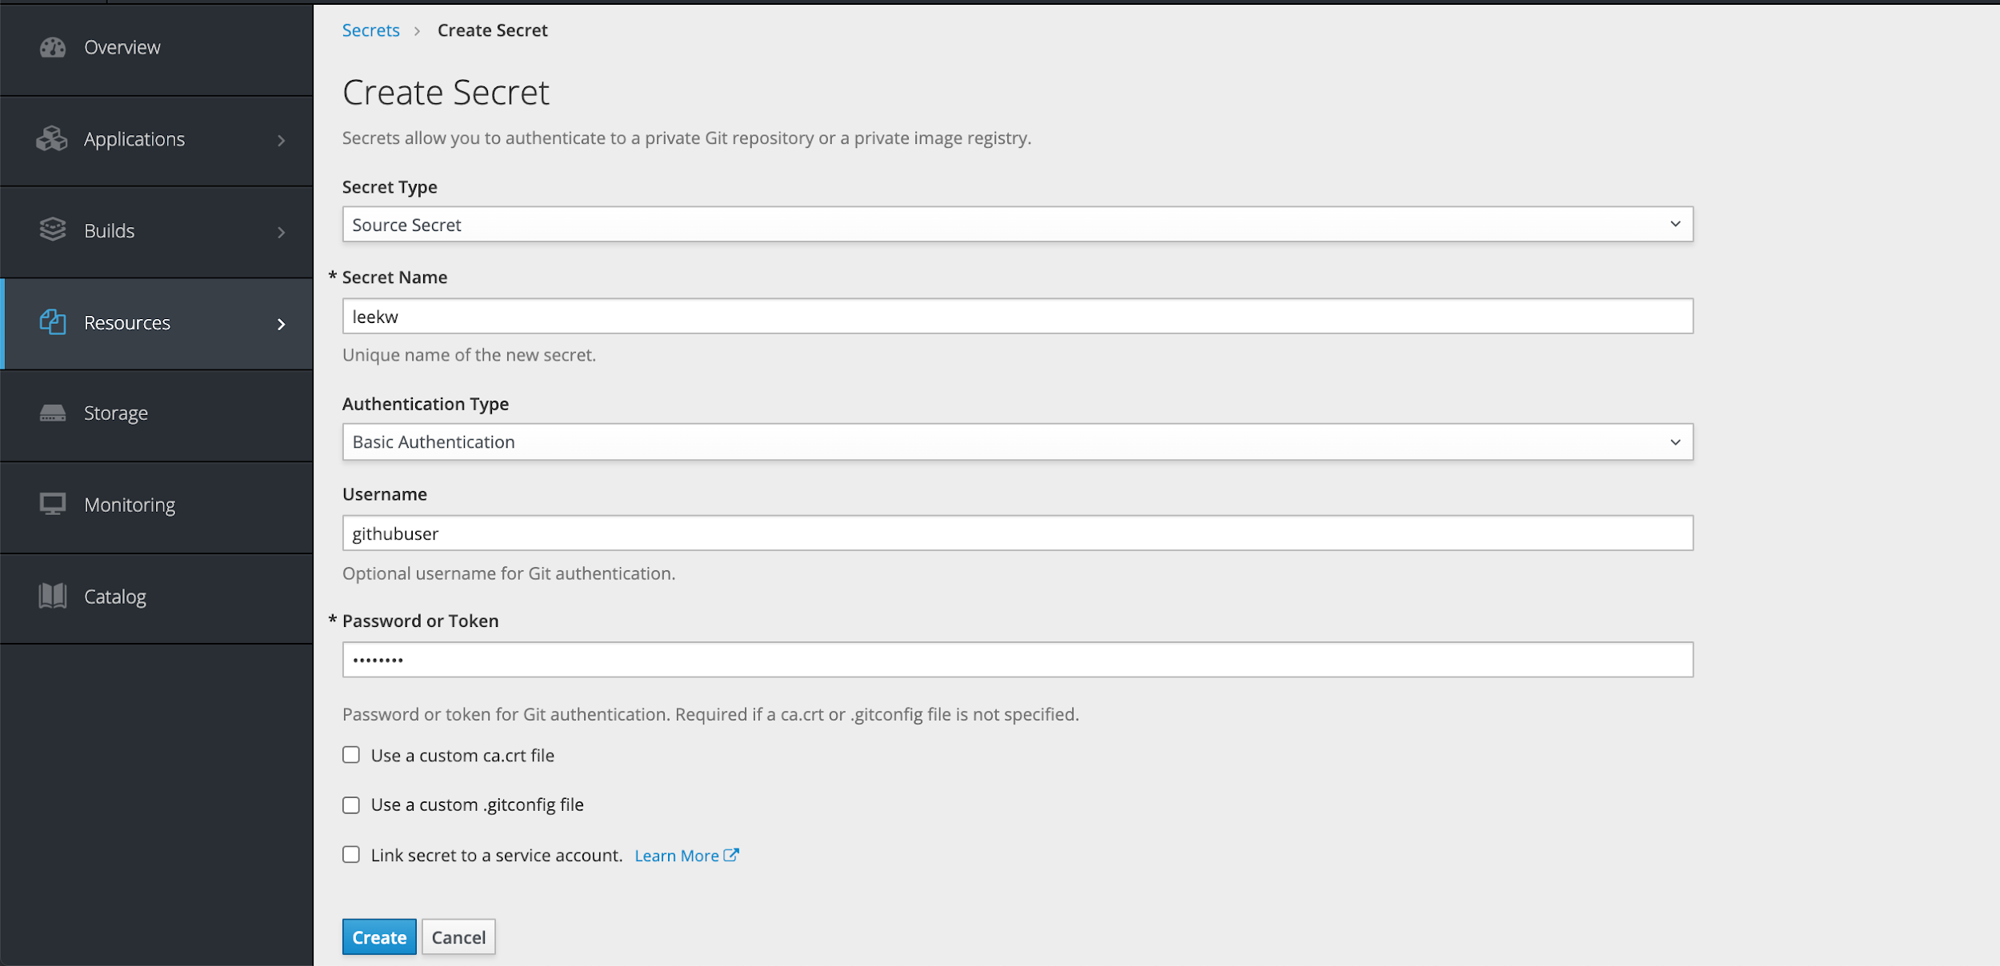
Creating New Applications
3. If your github repo is private, your have to first create a secret key using your github username and password:
In the Openshift web console: Resources > Secrets > Create Secret
Notes:
openshift.com/blog/create-s2i-builder-image

Slide 11
Creating New Applications
4. In your local terminal, run the oc new-app command
oc new-app https://github.com/luketankw/ALICE.git --source-secret=leekw --strategy=docker --context-dir=backend/AliceBackEnd/TopicModelling --name=topics
The first argument is the source of the github repo; --source-secret is the name of the secret used to access the private github repo; --strategy specifies the build strategy (either docker or source); --context-dir specifies the file directory of the build path.
Notes:
openshift.com/blog/create-s2i-builder-image

Slide 12
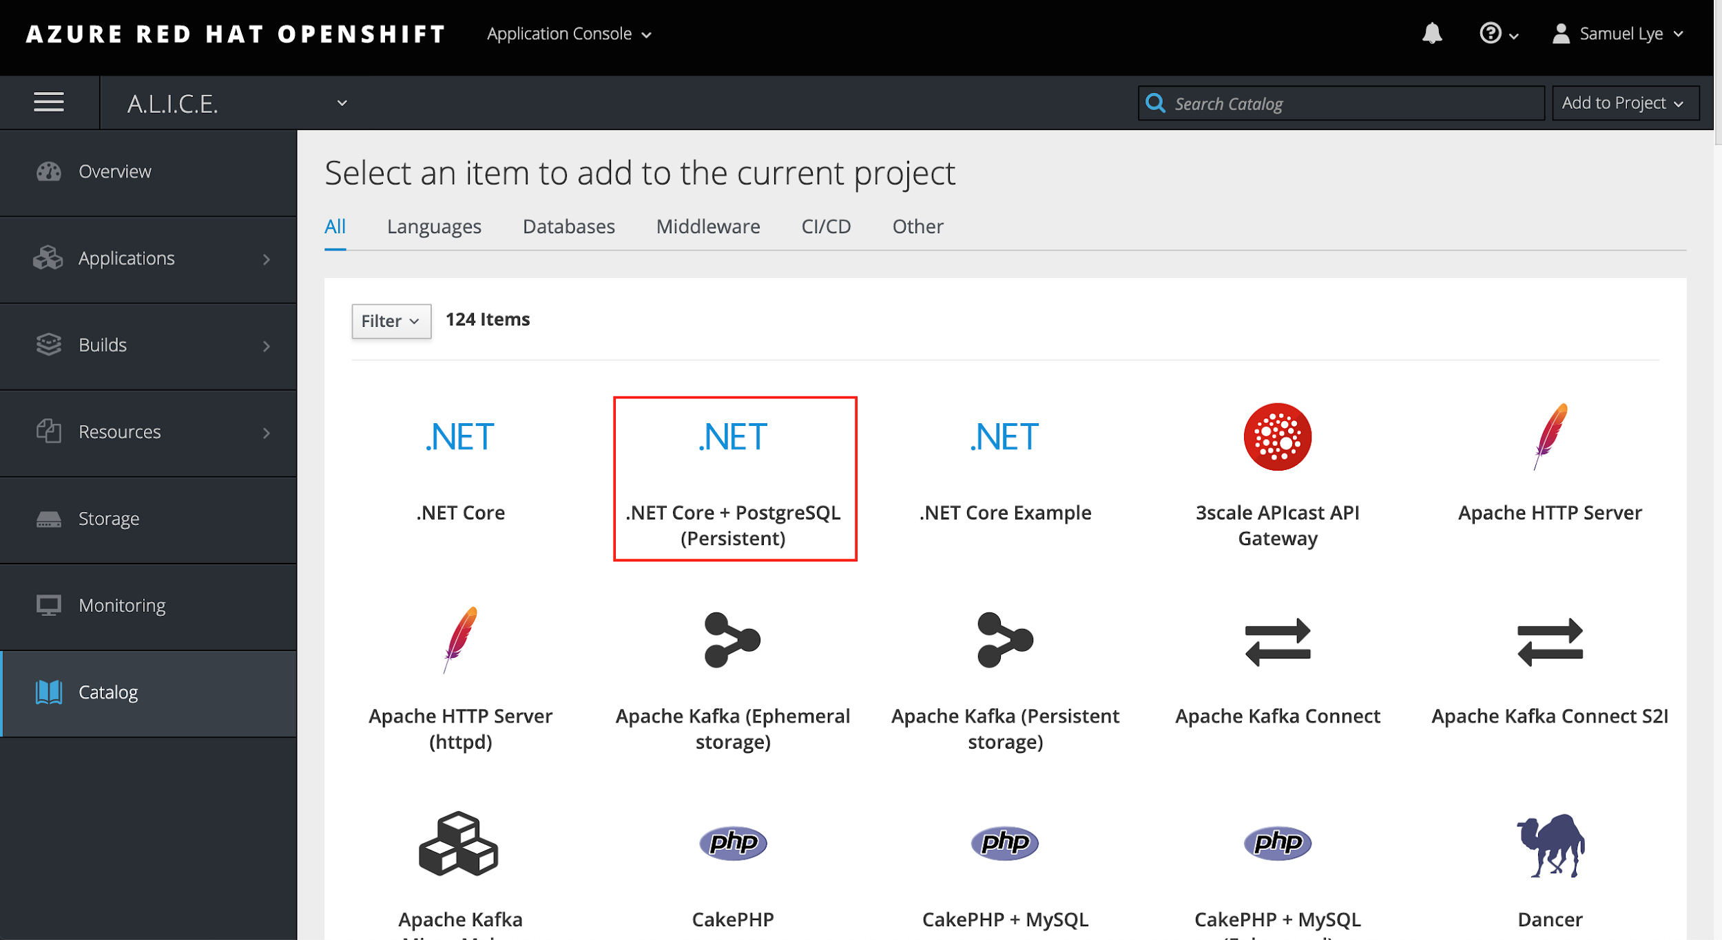
Creating New Applications
5. There was in issue we faced using the web console to create our application.
Openshift has multiple ways to create applications. We tried using the Source to Image (S2I) method which generates a new Docker image using source code and a builder Docker image, i.e. --strategy=source
However, using S2I ignores the Dockerfile in the github repo and is why we chose to use the Openshift terminal commands instead of the web console to create our application, i.e. --strategy=docker
Notes:
openshift.com/blog/create-s2i-builder-image

Slide 13
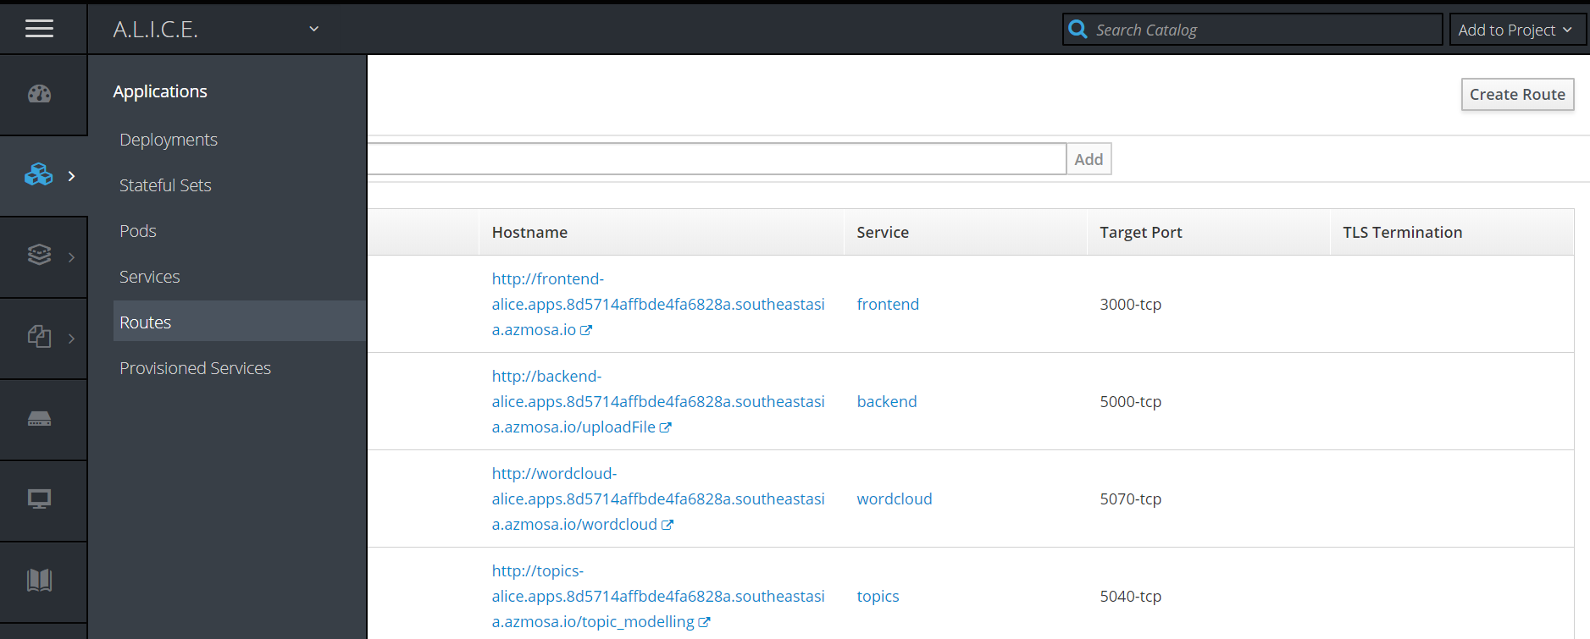
Routing

Slide 14
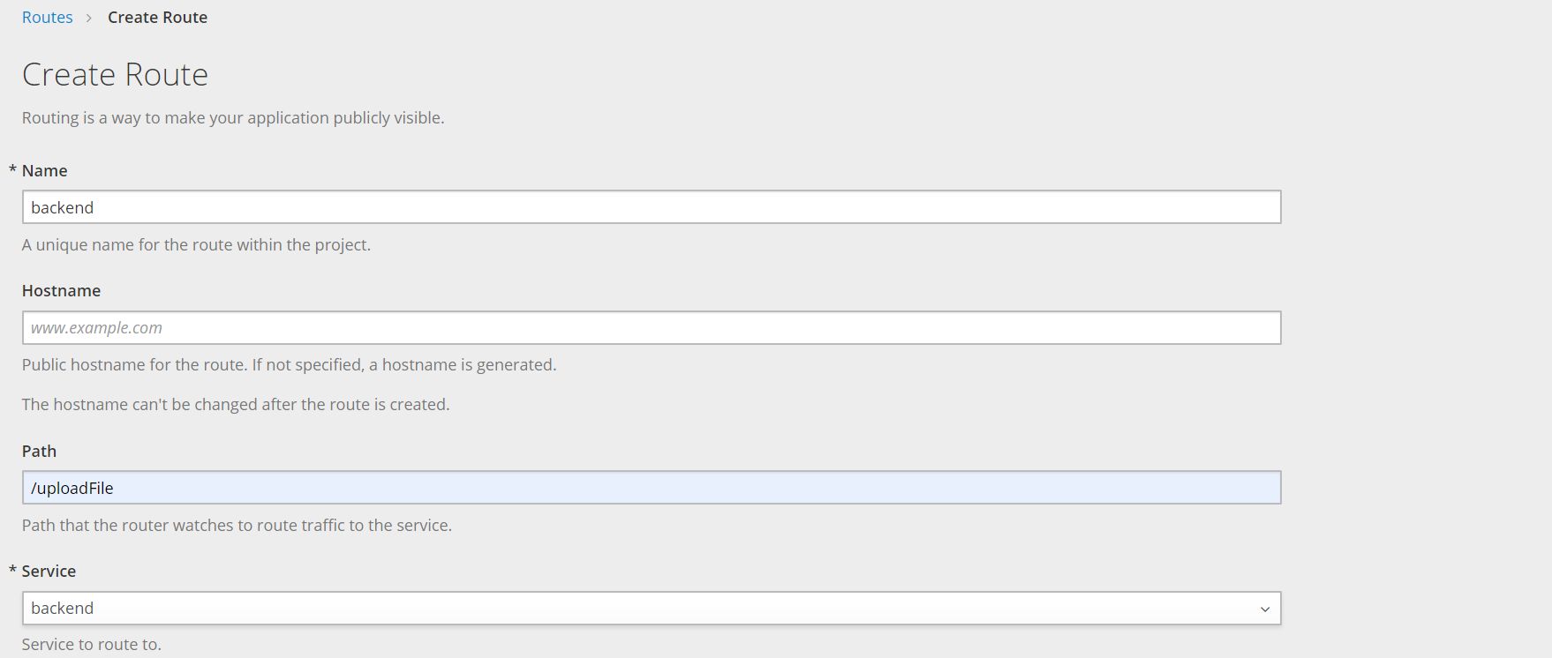
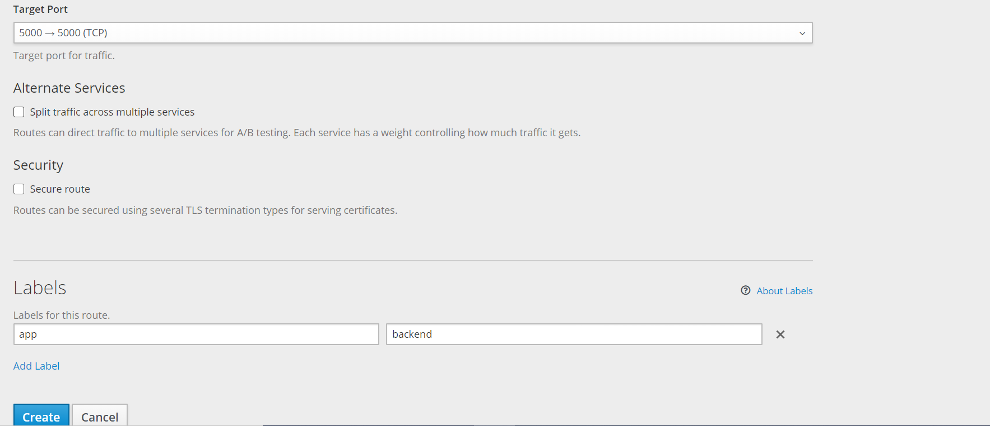
Routing

Slide 15
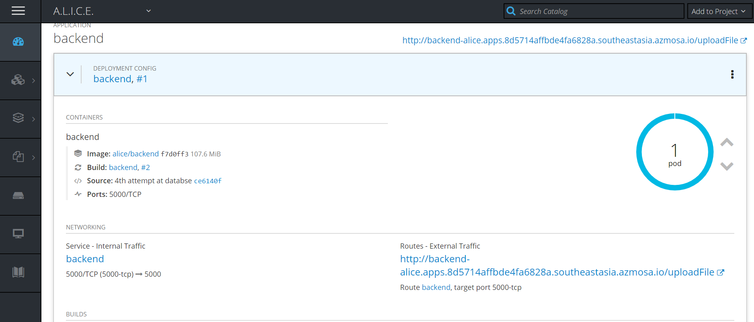
Routing

Slide 16
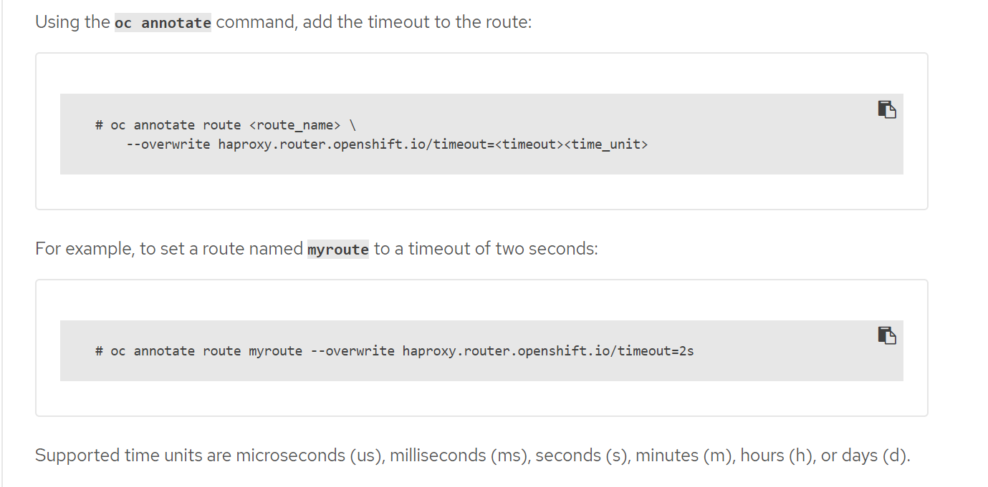
Routing

Slide 17
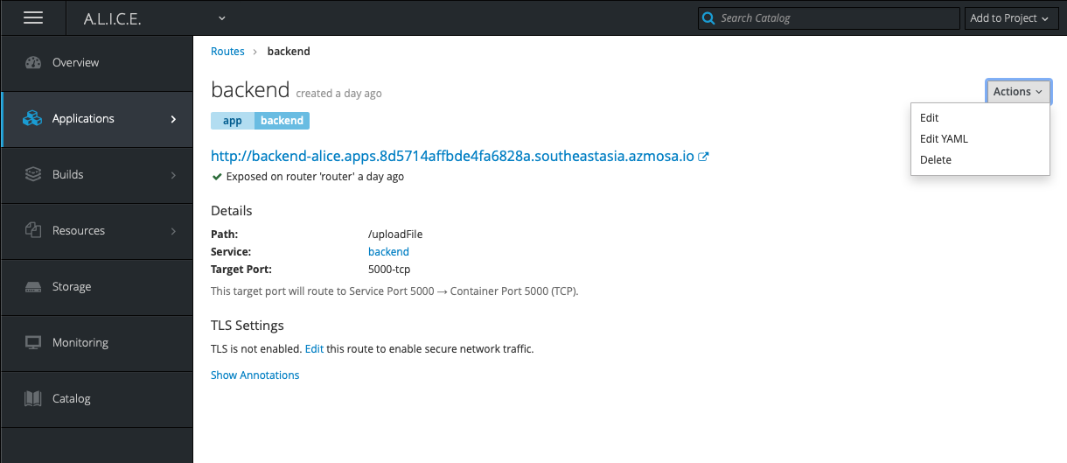
Routing

Slide 18
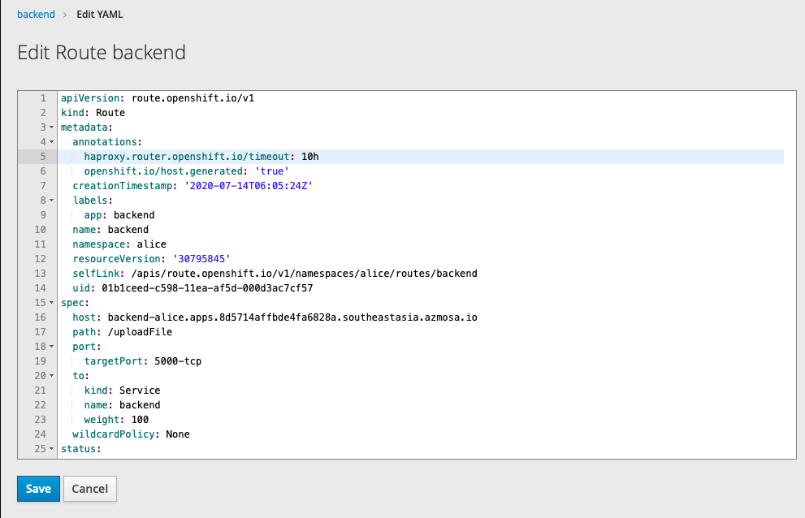
Routing

Slide 19
Architecture
Threading
Load Balancing
Auto Scaling
Each child thread runs
Topic Modelling
Sentiment
Classifier
….
Child thread 1: File 1
Topic Modelling
Child thread 2: File 2
(Each file runs on a separate thread in a pod)
.
.
Upload Page
Send 2 files
Relation Pod 1
Main Thread
Dashboard
Relation Pod 2
(Load balancing across 2 relation pods)
Frontend
Backend
(Relation Pod 3?)

Slide 20
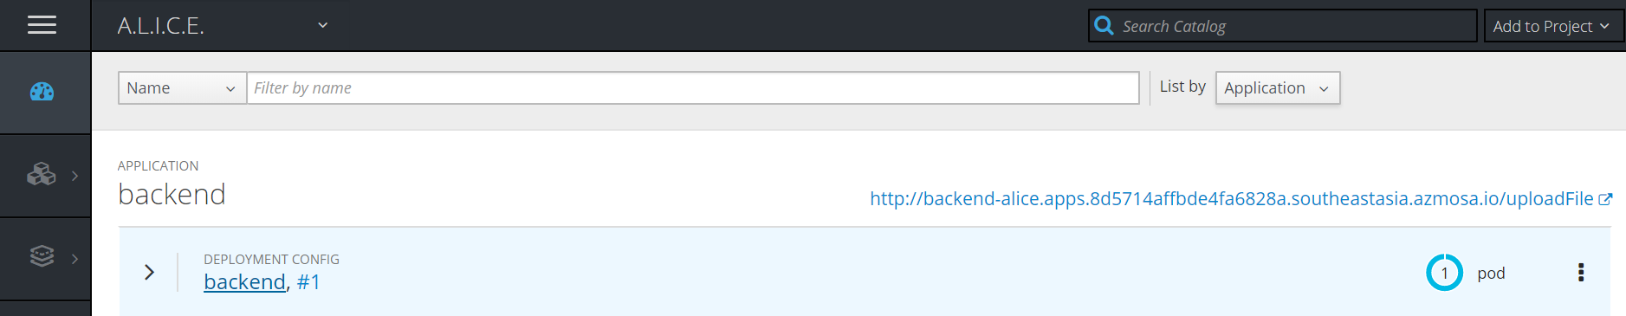
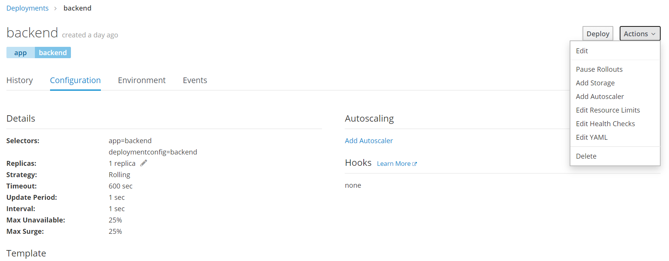
Auto Scaling

Slide 21
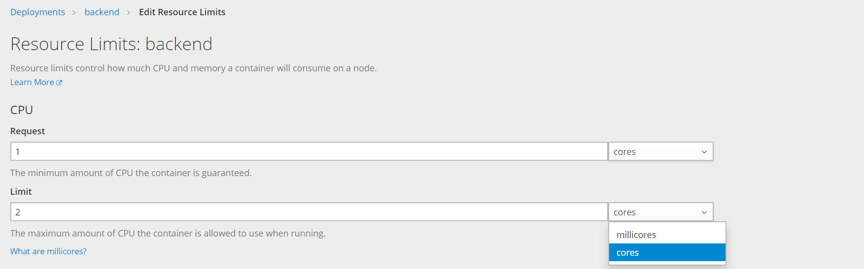
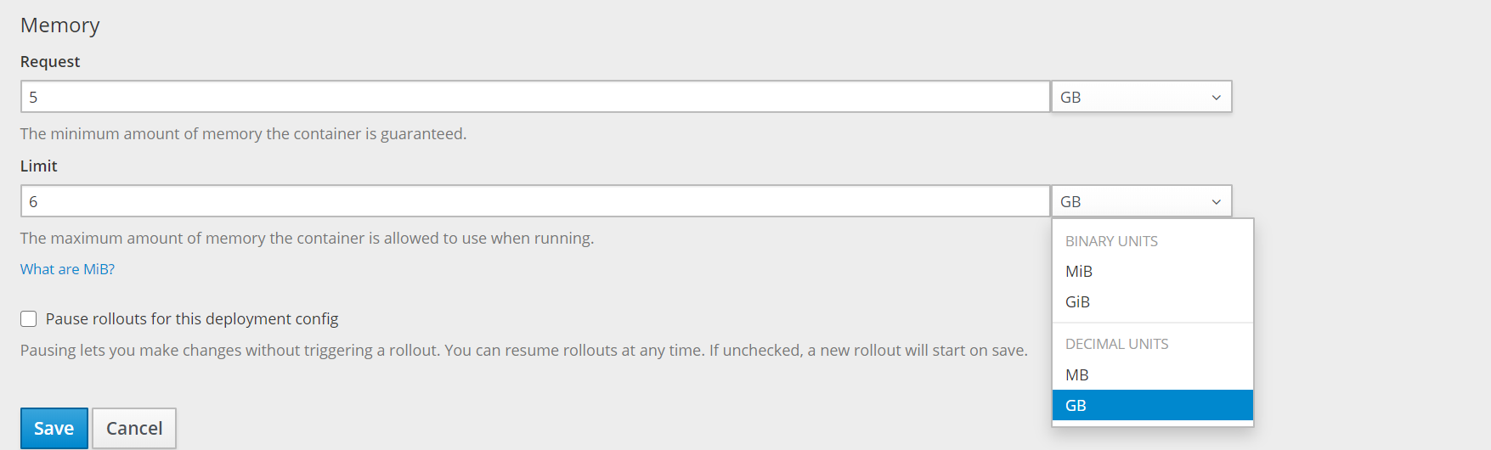
Auto Scaling

Slide 22
Auto Scaling

Slide 23
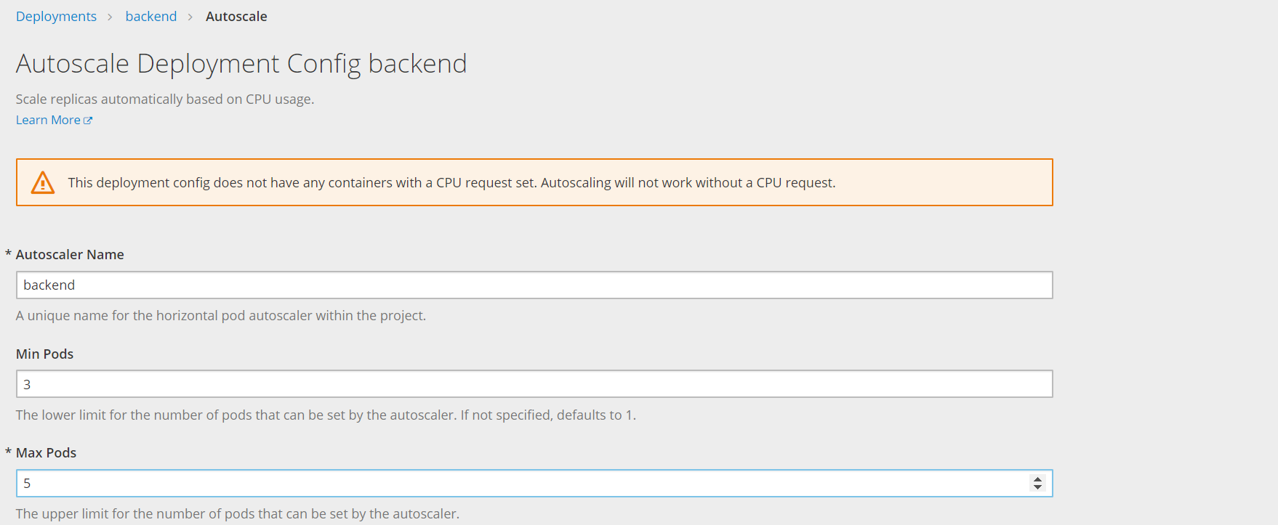
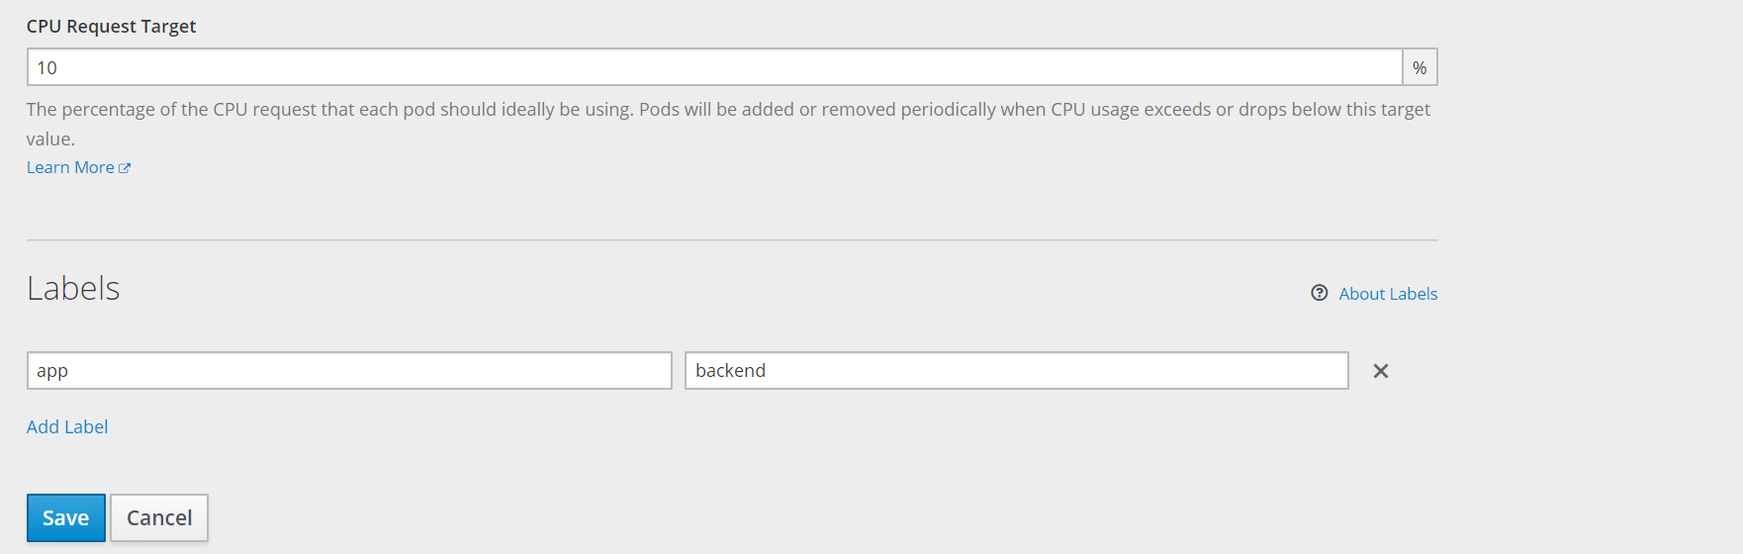
Auto Scaling

Slide 24
Load Balancing

Slide 25
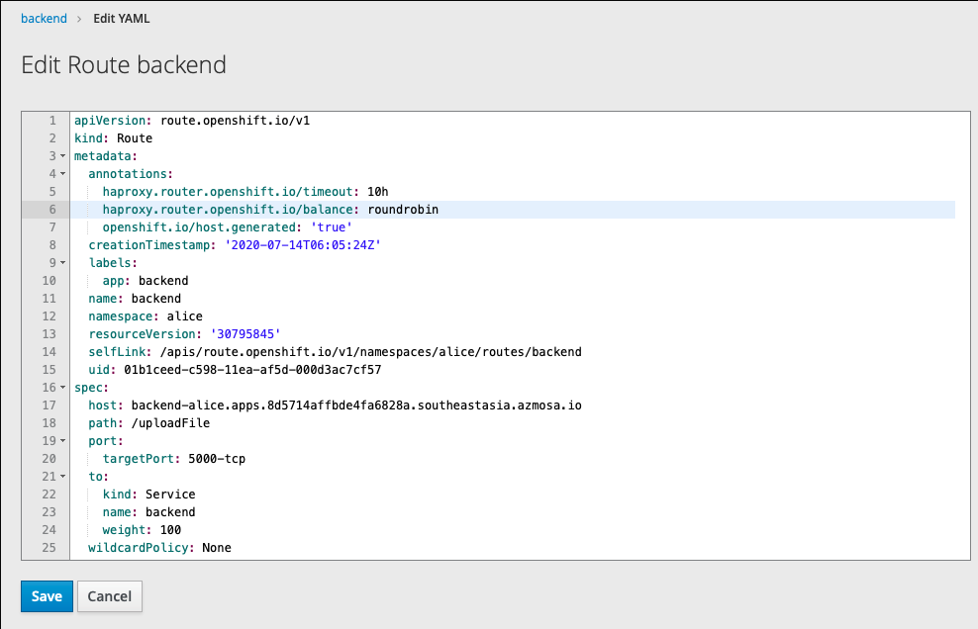
Load Balancing

Slide 26
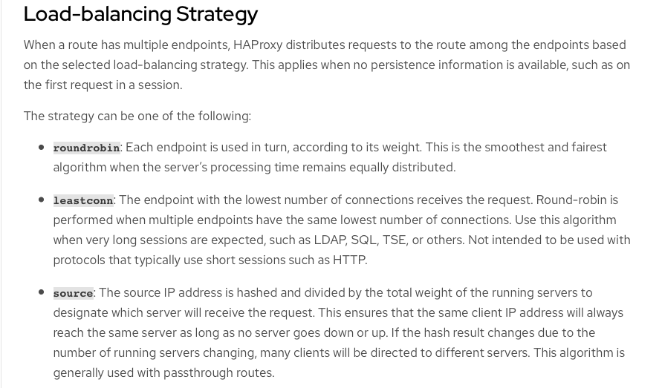
Load Balancing

Slide 27
Internship 2020
A.L.I.C.E.
Thank you!

